Slide 1
NPA 709 (Area Code) Relief in Newfoundland and
Labrador
September 20 – September 22, 2016

Slide 2
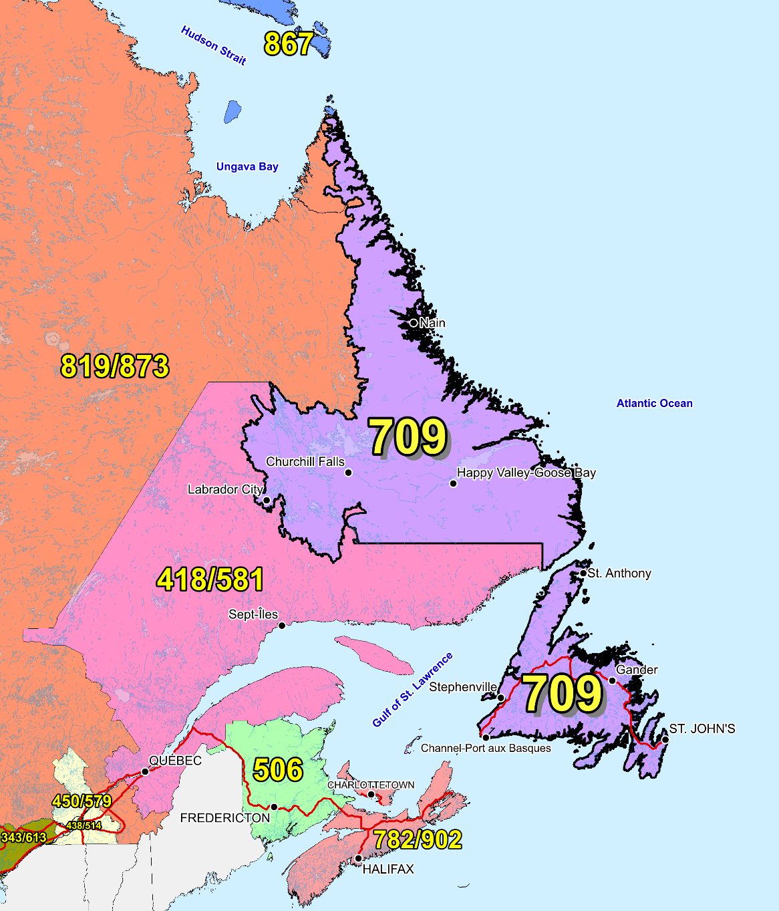
NPA 709 and
Adjacent Area Codes

Slide 3
NPA 709 Relief Planning Committee Meeting – Day 1
Tuesday, September 20, 2016
Murray Premises Hotel – St. John’s
9:00 Registration
9:15 Welcome and introductions
9:20 Approval of agenda
9:30 CNA review of Industry Guidelines
9:45 CNA role in the NPA Relief Planning Process
10:00 CRTC staff comments on the NPA Relief Planning Process/Telecom Notice of Consultation CRTC 2016-205
10:15 Break
10:30 Review of the NPA 709 Initial Planning Document
12:00 Lunch
13:00 Continued review of the NPA 709 Initial Planning Document
14:30 Break
15:00 Review of contributions
16:30 Adjourn

Slide 4
NPA 709 Relief Planning Committee Meeting – Day 2
Wednesday, September 21, 2016
Murray Premises Hotel – St. John’s
9:00 Welcome and introductions
9:05 Review of contributions
10:15 Break
10:30 Review of contributions/round-table
discussions of issues and alternatives
12:00 Lunch
13:00 Integration of contributions into Planning Document
14:30 Break
15:00 Integration of contributions into Planning Document
16:30 Adjourn

Slide 5
NPA 709 Relief Planning Committee Meeting – Day 3
Thursday, September 22, 2016
Murray Premises Hotel – St. John’s
9:00 Welcome and introductions
9:05 Review of Relief Implementation Schedule
10:15 Break
10:30 Develop Relief Implementation Plan based on contributions
12:00 Lunch
13:00 Continued development of Relief Implementation Plan
14:30 Break
15:00 Continued development of Relief Implementation Plan
16:00 Next Steps
16:30 Adjourn

Slide 6
NPA Relief Planning Principles and Considerations
The NPA relief plan chosen will seek to minimize end users’ confusion while balancing the cost of implementation by all affected parties.
If a relief plan requires customers to undergo number changes, the plan shall not require these customers to undergo further number changes until at least 8-10 years later.
All efforts should be made to choose a plan that does not favour a particular interest group, i.e., no relief plan should give one Carrier or group of Carriers a competitive advantage over other Carriers or groups of Carriers.

Slide 7
NPA Relief Planning Principles and Considerations (cont’d)
The NPA Code Relief Coordinator should facilitate the selection of a consensus NPA relief plan based on input as outlined below.
Communications should be established with all affected industry members, the CRTC and the North American Numbering Plan Administration (NANPA). This should be initiated immediately after the need for NPA Relief has been determined.

Slide 8
NPA Relief Planning Process
The NPA Relief Planning process is described in detail in the Canadian NPA Relief Planning Guideline.
This process requires participation by Affected Parties and other interested parties at meetings of the Relief Planning Committee (RPC) for the NPA requiring relief.
The major objective of the NPA relief planning process is to ensure an adequate supply of CO Codes is available at all times to the Canadian telecommunications industry (i.e., ensure that NPA Relief occurs in advance of NPA exhaust).

Slide 9
NPA Relief Planning Process (cont’d)
Another objective of the NPA Relief Planning process is to develop, in accordance with the Canadian NPA Relief Planning Guideline and its time frames, a consensus recommendation for an NPA relief plan to be submitted for CRTC approval.
It is the responsibility of all participants (e.g. Carriers, service providers, manufacturers, equipment suppliers, and users) to implement the CRTC-approved NPA relief plan.

Slide 10
NPA Relief Planning Process (cont’d.)
The Relief Options shall cover a period of at least eight years beyond the Projected Exhaust Date, and shall cover more than one relief activity, if necessary, during the time frame.
The relief Planning Document shall be a living document and will reflect changes that take place over time such as demand for CO Codes or other factors (e.g., local competition, wireline and wireless number portability, etc.) during the time it takes to create. The annual and relief planning NRUF analyses shall be used for updating the relief options.

Slide 11
NPA Relief Planning Process (cont’d.)
The recommendation for a Relief Method (e.g., distributed overlay, concentrated overlay) is made by the RPC, and shall be specified in the Planning Document. The estimated life of the relief shall be included in the Planning Document along with assumptions, projected code assignment rates, etc.
If a Relief Option requires customers to undergo number changes, the option shall not require these customers to undergo further number changes until at least 8-10 years later.

Slide 12
NPA Relief Planning Process (cont’d.)
In the long term, the plan shall result in the most effective use possible of all CO Codes serving a given area. Ideally, all of the CO Codes in a given area shall exhaust at about the same time. In practice this may not be possible, but severe imbalances shall be avoided.

Slide 13
The Roles and Responsibilities of the CNA in the NPA Relief Planning Process
Monitor CO Code Assignment and Availability
Conduct Special, Jeopardy or Relief Planning NRUFs
Notify Affected Parties, NANPA, iconectiv TRA and CRTC
Appoint a Meeting Moderator, an NPA Relief Coordinator and a Meeting Secretary
Prepare Initial Planning Document (IPD)
Issue Notice of Initial Meeting, and distribute IPD to Affected Parties and appropriate regulatory authorities

Slide 14
The Roles and Responsibilities of the CNA in the NPA Relief Planning Process (cont’d)
Conduct Initial NPA Relief Planning Meeting
Conduct subsequent NPA Relief Planning Meetings
Notify the NANPA and iconectiv TRA of the relief planning activities
Make a public announcement

Slide 15
Background
NPA 709 serves 211 Exchange Areas
NPA 709 serves the province of Newfoundland and Labrador
Most of the growth for existing service providers in area code 709 is concentrated in less than ten (10) Exchange Areas, with the majority of this growth being in the Exchange Areas of Corner Brook, Gander, Grand Falls, Happy Valley-Goose Bay, Labrador City-Wabush, Marystown and St. John’s
Projected Future Average Growth is 15 NXXs/year
NPA 709 is projected to exhaust in March 2019

Slide 16
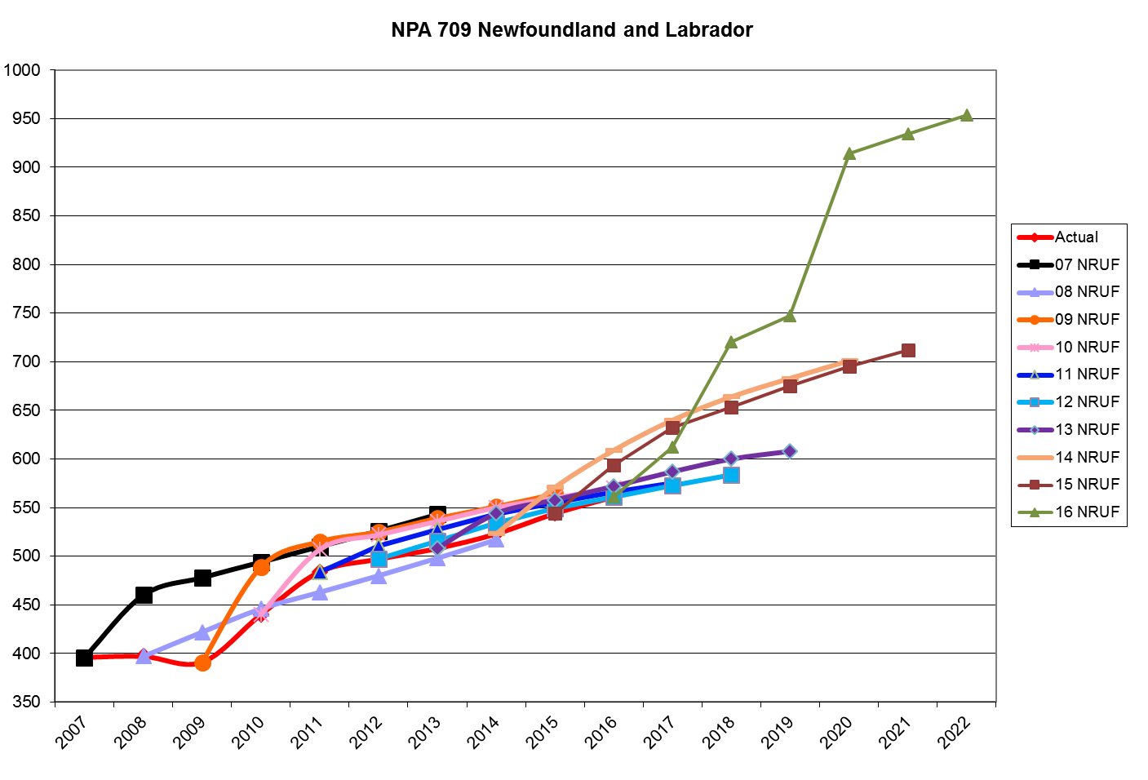
NPA 709 Actual and Forecast CO Code Assignments

Slide 17
NPA 709 CO Code Exhaust April 2016 J-NRUF

Slide 18
NPA 709 Admin and LEC+WSP CO Codes
April 2016 J-NRUF

Slide 19
NPA 709 CO Code Exhaust May 2016
NoC and April 2016 J-NRUF

Slide 20
NPA 709 Admin and LEC+WSP CO Codes
May 2016 NoC and April 2016 J-NRUF

Slide 21
CO Codes available for assignment in NPA 709
Total CO Codes in an NPA (NXX format) 800
CO Codes unassignable prior to a Jeopardy Condition:
N11 Service Codes (211, 311, 411, 511, 611, 711, 811 & 911) 8
Special Use Codes (555, 950 & 976) 3
Home NPA(s) (709) 1
Current Neighbouring NPA (418 & 581) 2
Future Canadian Geographic NPAs (354, 367, 382, 387, 474, 487, 568, 871, 879 & 942) 10
Plant Test Codes (958 & 959) 2
Special 7-Digit Dialing Codes (310, 610 & 810) 3
CO Codes from 709 NPA set aside for Initial Code Assignments for New Entrants only 2
911 Misdial Codes (912, 914 & 915) 3
Subtotal 34
Assignable CO Codes prior to a Jeopardy Condition 766
CO Codes that become assignable in a Jeopardy Condition
911 Misdial Codes (912, 914 & 915) 3
Future Canadian Geographic NPAs (354, 367, 382, 387, 474, 487, 568, 871 & 942) 9
Neighbouring NPAs ( 418 & 581) 2
Subtotal 14
Assignable CO Codes in a Jeopardy Condition 780
Assigned Codes on 05 August 2016 540
Available Codes on 05 August 2016
without a Jeopardy Condition 226
Available Codes on 05 August 2016
in a Jeopardy Condition 240

Slide 22
Relief Options
  Distributed Overlay – 1 option
  Option 1 – Distributed Overlay of New NPA Code on NPA 709
  Concentrated Overlay – 3 options
  Option 2 – Concentrated overlay the new NPA Code on
  Capital Coast LIR
  Option 3 – Concentrated overlay the new NPA Code on
  Humber LIR
  Option 4 – Concentrated overlay the new NPA Code on
  Capital Coast and Humber LIRs

Slide 23
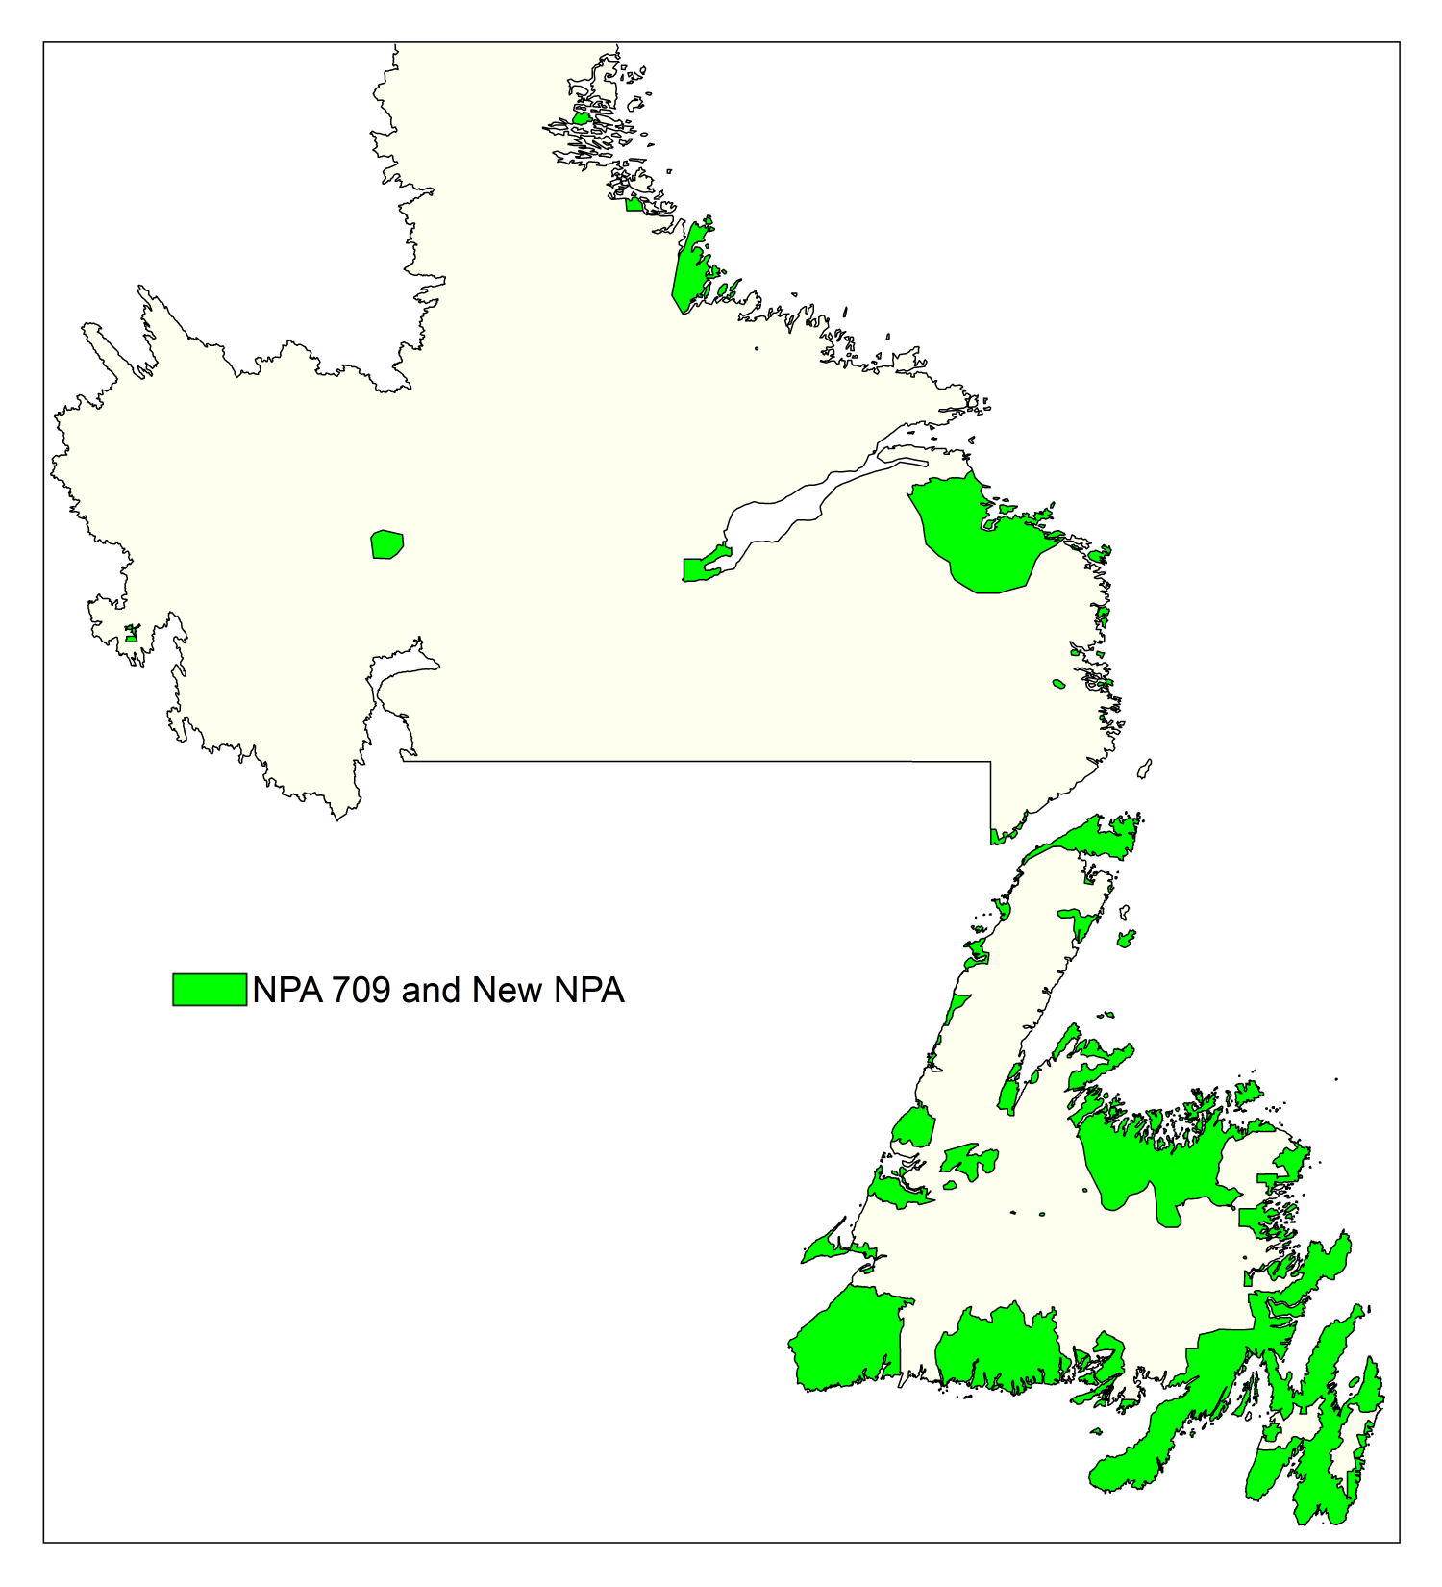
Option 1: Distributed Overlay of New NPA on NPA 709

Slide 24
Option 1: Distributed Overlay of New NPA on NPA 709
Currently, NPA 709 is expected to exhaust in the year 2019.
This Relief Option would overlay a New NPA Code on all 211 Exchange Areas in NPA 709.
NPA Code 709 and the New NPA Code would be expected to exhaust in 2060.
Customers’ telephone numbers would not change.

Slide 25
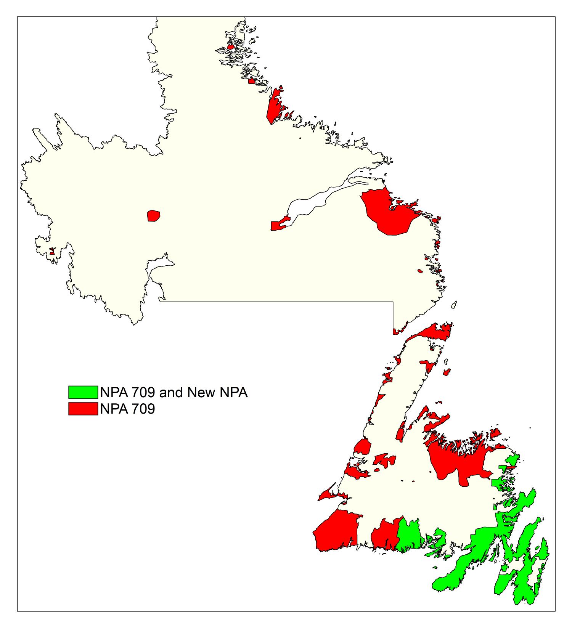
Option 2: Concentrated Overlay of new NPA Code on Capital Coast LIR

Slide 26
Option 2: Concentrated Overlay of new NPA Code on Capital Coast LIR
This Relief Option would overlay a New NPA Code over the Capital Coast LIR (87 Exchange Areas) and the remaining 124 Exchange Areas would continue to grow using NPA 709.
NPA Code 709 and the New NPA Code would be expected to exhaust in 2019 (June) and 2076 respectively.
Customers’ telephone numbers would not change.

Slide 27
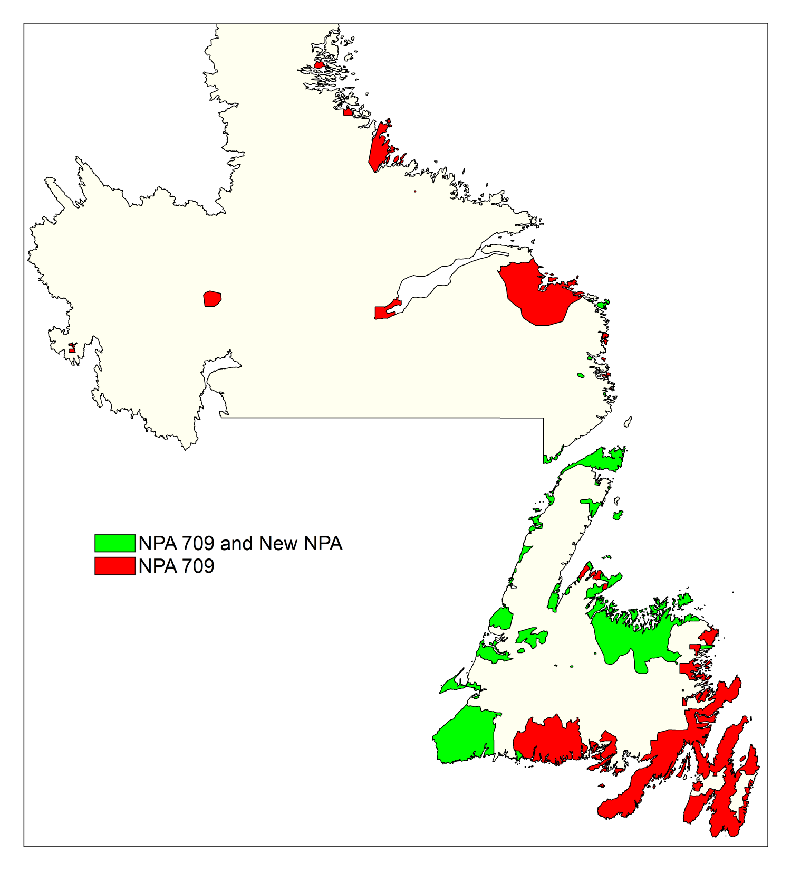
Option 3: Concentrated Overlay of new NPA Code on Humber LIR

Slide 28
Option 3: Concentrated Overlay of new NPA Code on Humber LIR
This Relief Option would overlay a New NPA Code over the Humber LIR (104 Exchange Areas) and the remaining 107 Exchange Areas would continue to grow using NPA 709.
NPA Code 709 and the New NPA Code would be expected to exhaust in 2019 (August) and 2076 respectively.
Customers’ telephone numbers would not change.

Slide 29
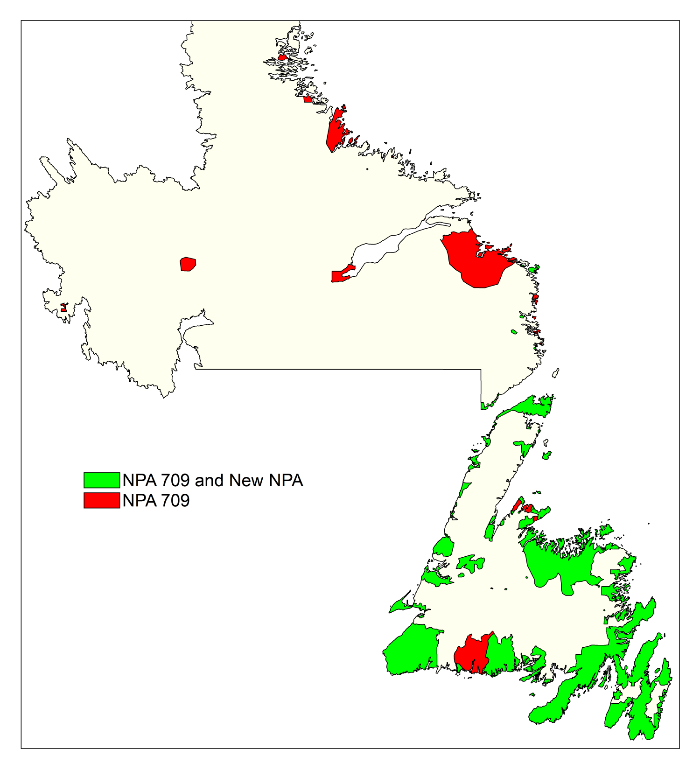
Option 4: Concentrated Overlay of new NPA Code on Capital Coast and Humber LIRs

Slide 30
Option 4: Concentrated Overlay of new NPA Code on Capital Coast and Humber LIRs
This Relief Option would overlay a New NPA Code over the Capital Coast and Humber LIRs (191 Exchange Areas) and the remaining 20 Exchange Areas would continue to grow using NPA 709.
NPA Code 709 and the New NPA Code would be expected to exhaust in 2072 and 2060 respectively.
Customers’ telephone numbers would not change.

Slide 31
Summary of Relief Options

Slide 32
Impacts
Customers
  in preparation for the assignment of CO Codes and telephone numbers in the new/extended NPA, customers must accommodate the additional NPA in their lists, tables, systems and equipment
Customers’ Equipment
  Automatic Dialer
  Fax Machines
  Call Forwarding
  Cellular Phones
  Burglar Alarms
  Voice Messaging Use
  Speed Calls List
  DISA Numbers
  CDR Software
  ACD Operations
  Modems
  PBXs
  Centrex
  Key Systems

Slide 33
Impacts (cont’d)
Telecommunications Service Providers
  systems etc. must accommodate additional NPA in the NPA 709 area
Telecommunication Operations
  Planning, Provisioning, Network Operations
Residential Sales and Service
  Business Office, I&R, Sales and Support
Corporate Communications
  Public Information
Finance
  Support
Business Division
  Sales, Public Communication Services, Customer Provided Equipment
Marketing
  Business Development, Forecast Rates and Tariff
System Solutions
  System Dev. (Network)
  System Dev. (Revenue)
Regulatory Matters

Slide 34
Impacts (cont’d)
Others
  Resellers, Rebillers
  International Carriers
  CPE Community: Vendors, Maintenance, Owners
  Radio Paging Community: Pagers and Beepers
  Industry Associations: Hotel, Alarm, Paging, Apartment Owners

