Slide 1
NPA 709 (Area Code) Relief in Newfoundland and Labrador
September 20 – September 22, 2016

Slide 2
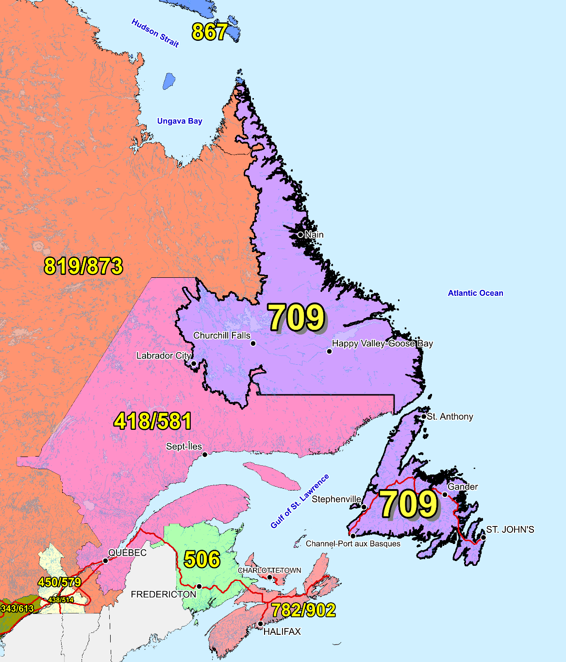
NPA 709 and Adjacent Area Codes

Slide 3
NPA 709 Relief Planning Committee Meeting – Day 1 Tuesday, September 20, 2016 Murray Premises Hotel – St. John’s
9:00 Registration
9:15 Welcome and introductions
9:20 Approval of agenda
9:30 CNA review of Industry Guidelines
9:45 CNA role in the NPA Relief Planning Process
10:00 CRTC staff comments on the NPA Relief Planning Process/Telecom Notice of Consultation CRTC 2016-205
10:15 Break
10:30 Review of the NPA 709 Initial Planning Document
12:00 Lunch
13:00 Continued review of the NPA 709 Initial Planning Document
14:30 Break
15:00 Review of contributions
16:30 Adjourn

Slide 4
NPA 709 Relief Planning Committee Meeting – Day 2 Wednesday, September 21, 2016 Murray Premises Hotel – St. John’s
9:00 Welcome and introductions
9:05 Review of contributions
10:15 Break
10:30 Review of contributions/round-table
discussions of issues and alternatives
12:00 Lunch
13:00 Integration of contributions into Planning Document
14:30 Break
15:00 Integration of contributions into Planning Document
16:30 Adjourn

Slide 5
NPA 709 Relief Planning Committee Meeting – Day 3 Thursday, September 22, 2016 Murray Premises Hotel – St. John’s
9:00 Welcome and introductions
9:05 Review of Relief Implementation Schedule
10:15 Break
10:30 Develop Relief Implementation Plan based on contributions
12:00 Lunch
13:00 Continued development of Relief Implementation Plan
14:30 Break
15:00 Continued development of Relief Implementation Plan
16:00 Next Steps
16:30 Adjourn

