Slide 1
NPA 506 (Area Code) Relief in New Brunswick
September 12-14, 2017
Updated information has been added as of 8 Sep. 2017 due to the release of the July 2017 R-NRUF results for the benefit of the RPC.

Slide 2
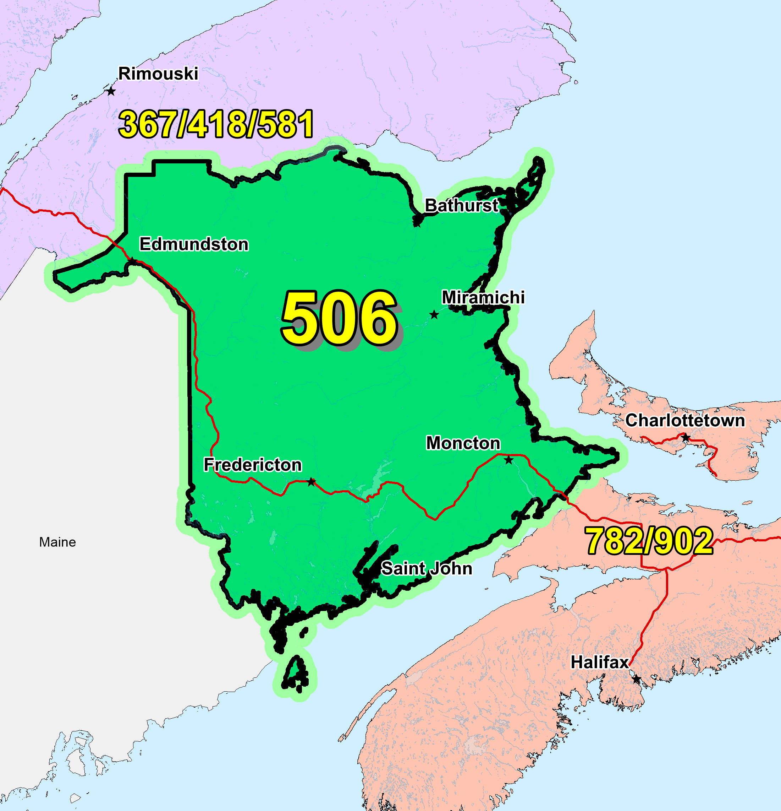
NPA 506

Slide 3
NPA 506 Relief Planning Committee Meeting – Day 1
Tuesday, September 12, 2017
Delta Hotel - Fredericton
9:00 Registration
9:15 Welcome and introductions
9:20 Approval of agenda
9:30 CNA review of Industry Guidelines
9:45 CNA role in the NPA Relief Planning Process
10:00 CRTC staff comments on the NPA Relief Planning / Telecom Notice of Consultation CRTC 2016‑206
10:15 Break
10:30 Review of the NPA 506 Initial Planning Document
12:00 Lunch
13:00 Continued review of the NPA 506 Initial Planning Document
14:30 Break
15:00 Review of Relief Implementation Schedule
16:30 Adjourn

Slide 4
NPA 506 Relief Planning Committee Meeting – Day 2
Wednesday, September 13, 2017
Delta Hotel - Fredericton
9:00 Welcome and introductions
9:15 Review of contributions/round-table discussion of issues and alternatives
10:15 Break
10:30 Integration of contributions into Planning Document
12:00 Lunch
13:00 Integration of contributions into Planning Document
14:30 Break
15:00 Review of contributions
16:30 Adjourn

Slide 5
NPA 506 Relief Planning Committee Meeting – Day 3
Thursday, September 14, 2017
Delta Hotel - Fredericton
9:00 Welcome and introductions
9:15 Develop Relief Implementation Plan based on contributions
10:15 Break
10:30 Develop Relief Implementation Plan based on contributions
12:00 Lunch
13:00 Develop Relief Implementation Plan based on contributions
14:30 Break
15:00 Next Steps
16:30 Adjourn

Slide 6
NPA Relief Planning Principles and Considerations
The NPA relief plan chosen will seek to minimize end users’ confusion while balancing the cost of implementation by all affected parties.
If a relief plan requires customers to undergo number changes, the plan shall not require these customers to undergo further number changes until at least 8-10 years later.
All efforts should be made to choose a plan that does not favour a particular interest group, i.e., no relief plan should give one Carrier or group of Carriers a competitive advantage over other Carriers or groups of Carriers.

Slide 7
NPA Relief Planning Principles and Considerations (cont’d)
The NPA Code Relief Coordinator should facilitate the selection of a consensus NPA relief plan based on input from the industry and the public.
Communications should be established with all affected industry members, the CRTC and the North American Numbering Plan Administration (NANPA). This should be initiated immediately after the need for NPA Relief has been determined.

Slide 8
NPA Relief Planning Process
The NPA Relief Planning process is described in detail in the Canadian NPA Relief Planning Guideline.
This process requires participation by Affected Parties and other interested parties at meetings of the Relief Planning Committee (RPC) for the NPA requiring relief.
The major objective of the NPA relief planning process is to ensure an adequate supply of CO Codes is available at all times to the Canadian telecommunications industry (i.e., ensure that NPA Relief occurs in advance of NPA exhaust).

Slide 9
NPA Relief Planning Process (cont’d)
Another objective of the NPA Relief Planning process is to develop, in accordance with the Canadian NPA Relief Planning Guideline and its time frames, a consensus recommendation for an NPA relief plan to be submitted for CRTC approval.
It is the responsibility of all participants (e.g. Carriers, service providers, manufacturers, equipment suppliers, and users) to implement the CRTC-approved NPA relief plan.

Slide 10
NPA Relief Planning Process (cont’d)
The Relief Options shall cover a period of at least eight years beyond the Projected Exhaust Date, and shall cover more than one relief activity, if necessary, during the time frame.
The relief Planning Document shall be a living document and will reflect changes that take place over time such as demand for CO Codes or other factors (e.g., local competition, wireline and wireless number portability, etc.) during the time it takes to create. The annual and relief planning NRUF analyses shall be used for updating the Relief Options.

Slide 11
NPA Relief Planning Process (cont’d)
The recommendation for a Relief Method (e.g., distributed overlay, concentrated overlay) is made by the RPC, and shall be specified in the Planning Document. The estimated life of the relief shall be included in the Planning Document along with assumptions, projected code assignment rates, etc.
If a Relief Option requires customers to undergo number changes, the option shall not require these customers to undergo further number changes until at least 8-10 years later.
In the long term, the plan shall result in the most effective use possible of all CO Codes serving a given area. Ideally, all of the CO Codes in a given area shall exhaust at about the same time. In practice this may not be possible, but severe imbalances shall be avoided.

Slide 12
The Roles and Responsibilities of the CNA in the NPA Relief Planning Process
Monitor CO Code Assignment and Availability
Conduct Special, Jeopardy or Relief Planning NRUFs
Notify Affected Parties, NANPA, iconectiv TRA and CRTC
Appoint a Meeting Moderator, an NPA Relief Coordinator and a Meeting Secretary
Prepare Initial Planning Document (IPD)

Slide 13
The Roles and Responsibilities of the CNA in the NPA Relief Planning Process (cont’d)
Issue Notice of Initial Meeting, and distribute IPD to interested parties and appropriate regulatory authorities
Conduct Initial NPA Relief Planning Meeting
Conduct subsequent NPA Relief Planning Meetings and conference calls
Notify the NANPA and iconectiv TRA of the relief planning activities
Make a public announcement

Slide 14
Background
Area Code 506 consists of 88 Exchange Areas serving the province of New Brunswick.
Most of the growth for existing service providers in Area Code 506 is concentrated in less than ten (10) Exchange Areas. However the growth resulting from service providers introducing initial service in new areas is spread over a larger number of Exchange Areas throughout Area Code 506, with proportionally greater growth occurring outside the major communities. The total combined growth is therefore not concentrated in or limited to the Exchange Areas serving the major communities.
The CNA has analysed the January 2017 R‑NRUF results and has concluded that the average actual annual forecast growth is approximately 21 CO Codes per year.
The rest of the forecast demand is due to CO Code requests for establishing a footprint in NPA 506 Exchange Areas.

Slide 15
NPA 506 Actual and Forecast CO Code Assignments

Slide 16
NPA 506 CO Code Exhaust: January 2016 G-NRUF

Slide 17
NPA 506 Admin and LEC+WSP Codes: January 2016 G‑NRUF

Slide 18
NPA 506 CO Code Exhaust: January 2017 R-NRUF
UPDATE: PED has moved from Dec. 2021 to Nov. 2024 based on July 2017 R-NRUF results

Slide 19
NPA 506 Admin and LEC+WSP Codes: January 2017 R‑NRUF
UPDATE: PED has moved from Dec. 2021 to Nov. 2024 based on July 2017 R-NRUF results

Slide 20
CO Codes Available for Assignment in NPA 506
 |  | Quantity
A | Total CO Codes in NPAs 506 (NXX format) | 800
B | CO Codes unassignable prior to a Jeopardy Condition
 | N11 Service Codes (211, 311, 411, 511, 611, 711, 811, 911) | 8
 | Special Use Codes (555, 950 & 976) | 3
 | Home NPA Code(s) (506) | 1
 | Current Neighbouring NPA Codes (782, 902) | 2
 | Future Geographic NPA Codes (257, 354, 428, 487, 537, 568, 584, 683, 942) (Note 1) | 9
 | Plant Test Codes (958 & 959) | 2
 | Special 7-digit Dialling Codes (610 & 810) | 2
 | CO Codes set aside for Initial Codes only | 4
 | CO Codes set aside for New Entrants only | 3
 | 9-1-1 Misdial Codes (912, 914 & 915) | 3
 | U.S. Dialling Problems (State of Maine) | 1
 | Total B | 38
C | CO Codes assignable prior to a Jeopardy Condition (C=A-B) | 762
D | CO Codes unassignable prior to a Jeopardy Condition that become assignable in a Jeopardy Condition:
 | Future Canadian Geographic NPA Codes (257, 354, 487, 537, 568, 584, 683, 942) (Note 2) | 8
 | Current Neighbouring NPA Codes (assign CO Code 782 and 902 in certain portion of NPA 506) (Note 3) | 2
 | 911 Misdial Codes (912, 914 & 915) | 3
 | Total D | 13
E | Assignable CO Codes in a Jeopardy Condition (E=C+D) | 775
F | Assigned CO Codes as of 30 June 2017 | 529
G | Net CO Codes available for assignment as of 30 June 2017 without a Jeopardy Condition (G=C-F) | 233
H | Net CO Codes available for assignment as of 30 June 2017 in a Jeopardy Condition (H=E-F) | 246

Slide 21
Relief Options
1 distributed overlay and 5 concentrated overlay Relief Options were evaluated
The distributed overlay Relief Options are dependent on the Local Interconnection Regions (LIRs) in NPA 506 as shown in the table below:
LIR Abbreviation | LIR Full Name
GLOUCESTER | Gloucester - Bathurst
MADAWASKA | Madawaska - Edmundston
NORTHUBRLD | Northumberland - Newcastle/Miramichi
SAINT JOHN | Saint John - Saint John
WESTMORLD | Westmorland - Moncton
YORK | York - Fredericton

Slide 22
Relief Options
Distributed Overlay – 1 Option
Option 1: Distributed Overlay
Concentrated Overlay – 5 Options
Option 2: Concentrated Overlay on MADAWASKA, NORTHUBRLD, SAINT JOHN, WESTMORLD and YORK LIRs
Option 3: Concentrated Overlay on GLOUCESTER, MADAWASKA, NORTHUBRLD, WESTMORLD and YORK LIRs
Option 4: Concentrated Overlay on SAINT JOHN and WESTMORLD LIRs
Option 5: Concentrated Overlay on SAINT JOHN, WESTMORLD and YORK LIRs
Option 6: Concentrated Overlay on NORTHUBRLD, SAINT JOHN, WESTMORLD and YORK LIRs

Slide 23
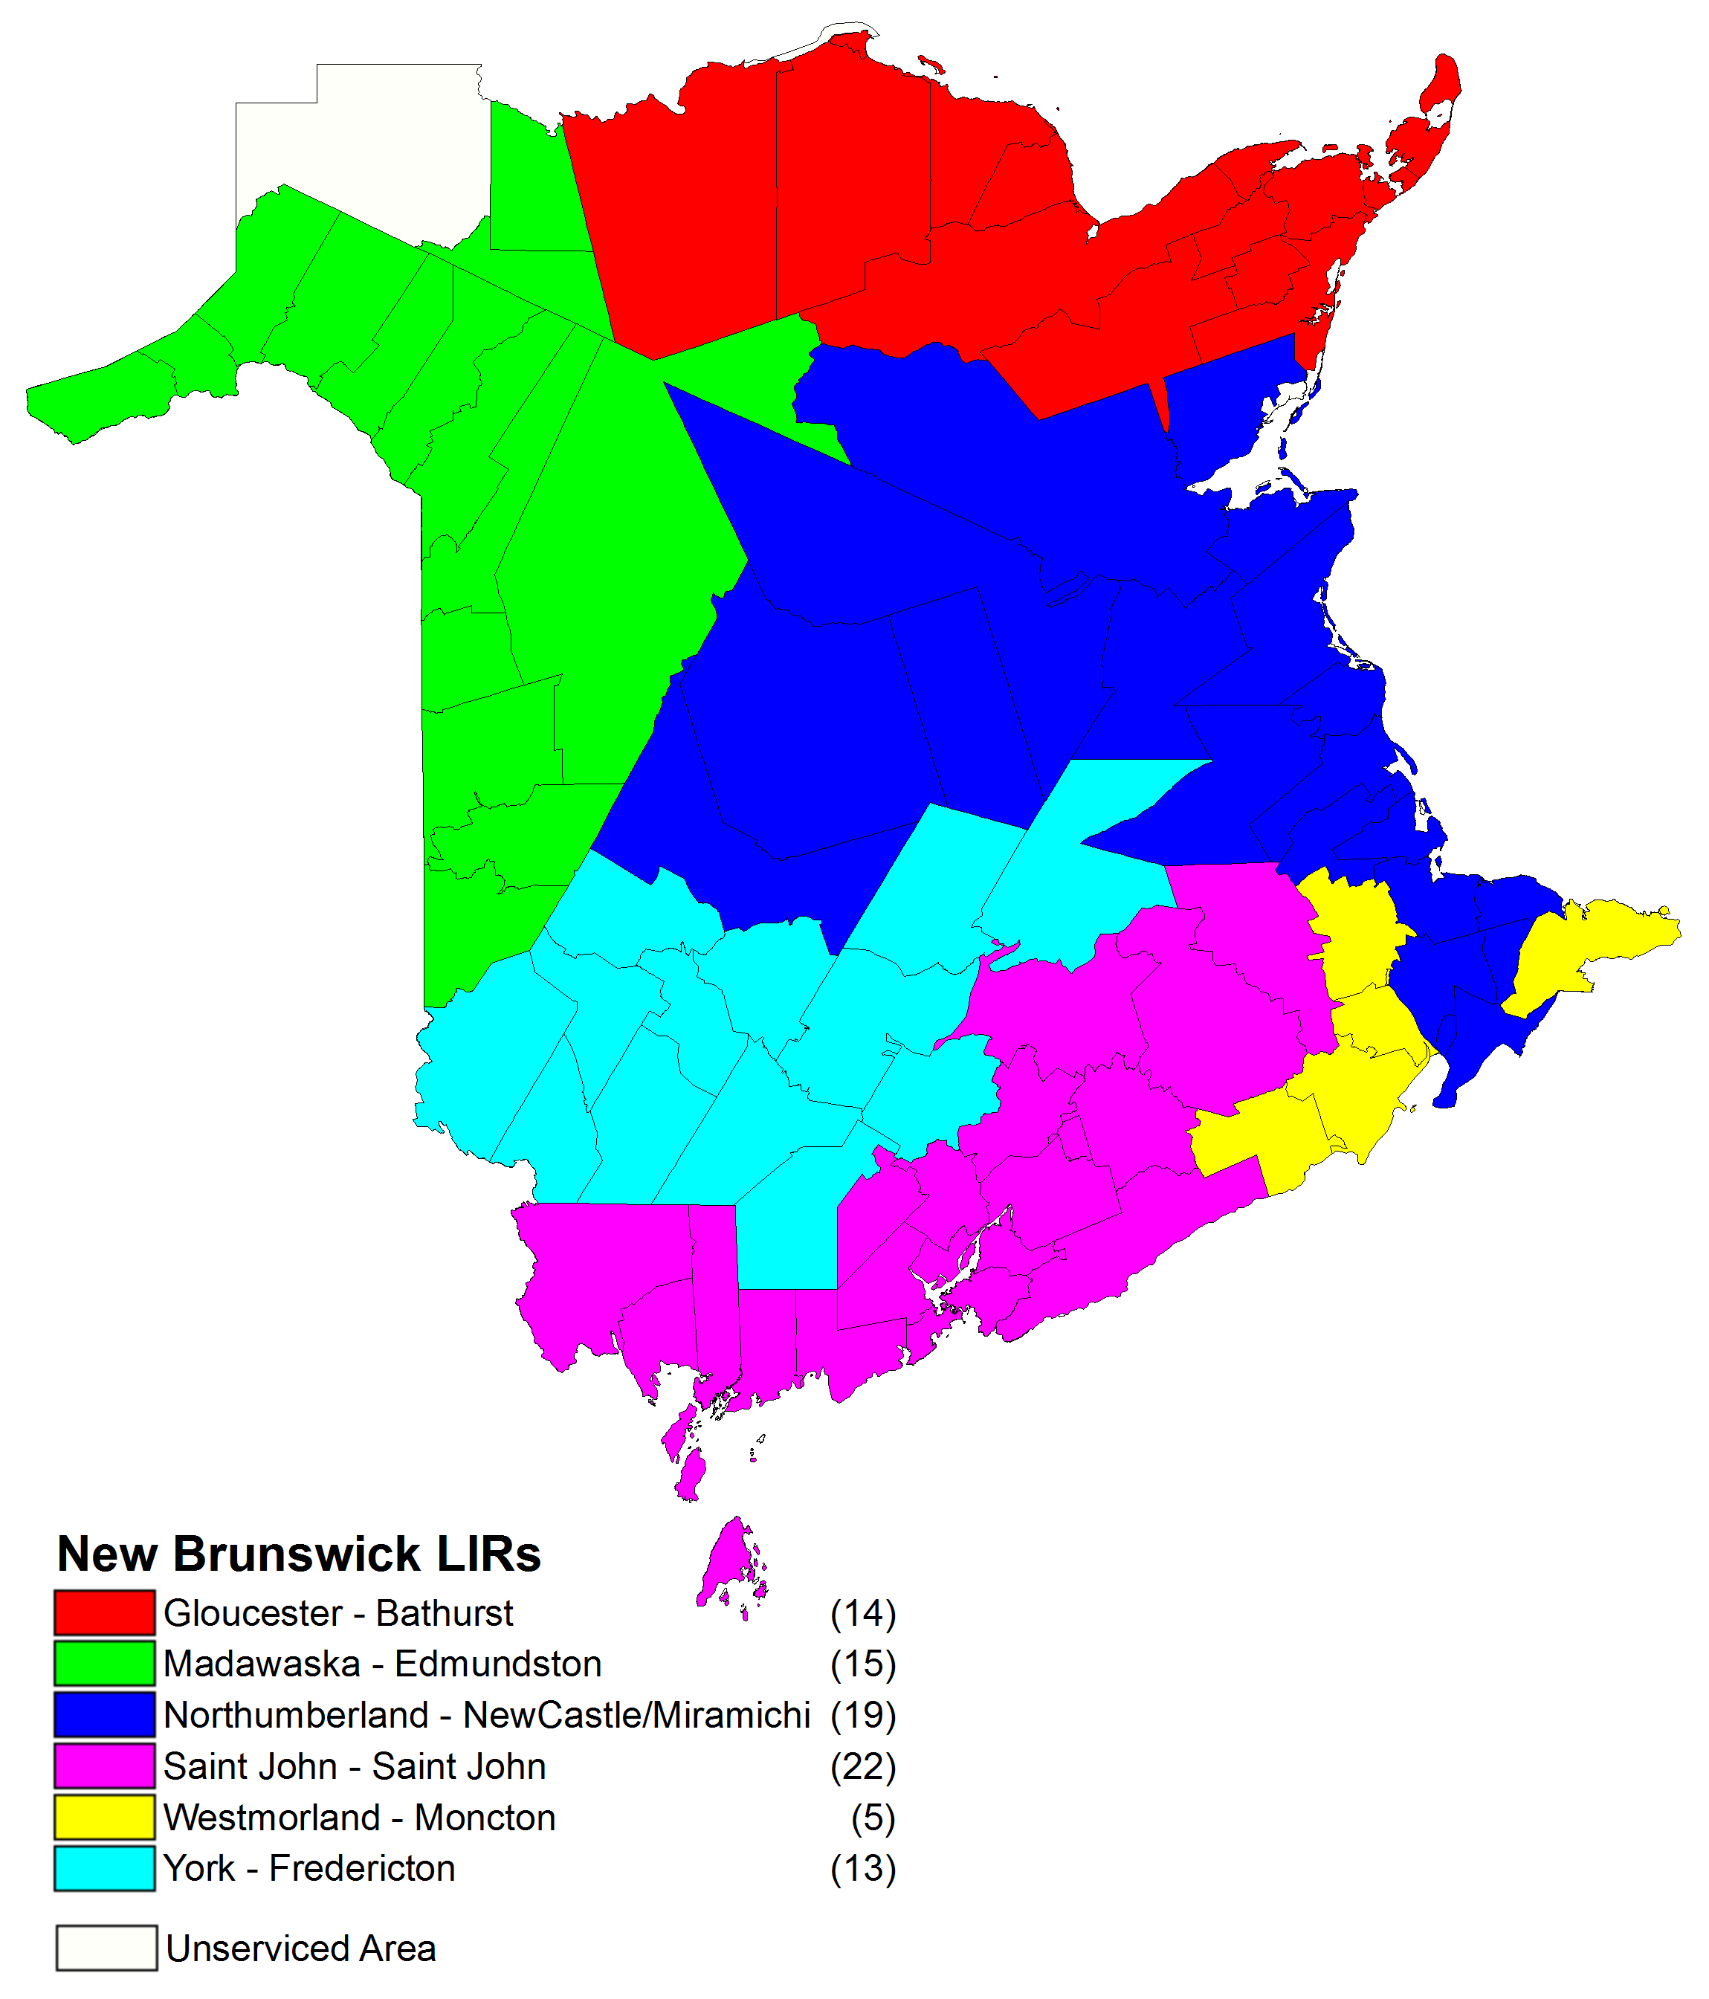

Slide 24
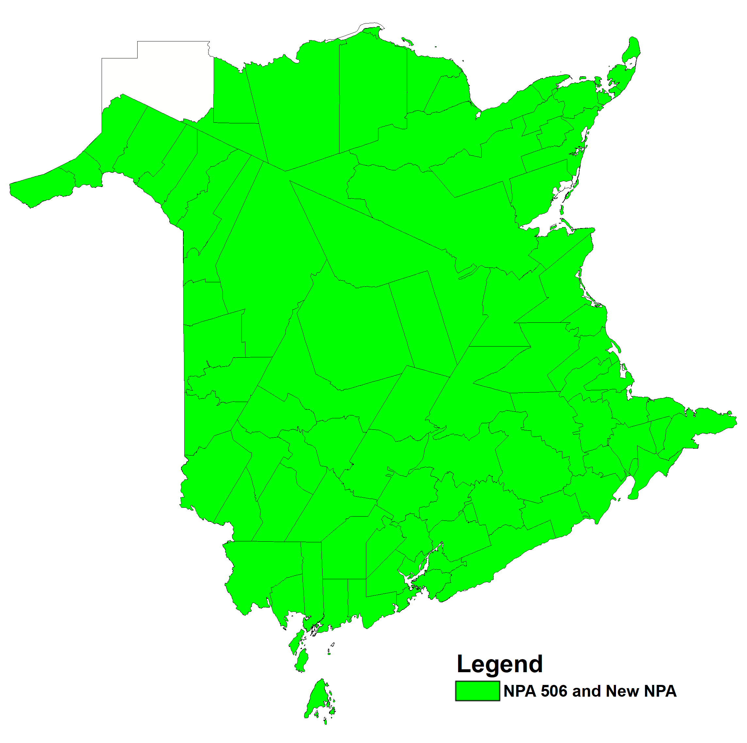
Option 1: Distributed Overlay of New NPA on NPA 506

Slide 25
Option 1: Distributed Overlay of New NPA on NPA 506
This Relief Option would introduce a new NPA Code as an overlay on all 88 Exchange Areas in the NPA 506 area.
With this Relief Option, the number of separate Relief Planning areas in New Brunswick would not change.
Relief would have to be implemented by 4Q 2020.
After this distributed overlay, NPA 506 will exhaust in 4Q 2021 and the new NPA would be expected to exhaust in 2053.
Based on July 2017 R-NRUF results, latest implementation date is 2Q 2023.
Based on July 2017 R-NRUF results, NPA 506 will exhaust in 4Q 2024 and the new NPA would exhaust in 4Q 2055.

Slide 26
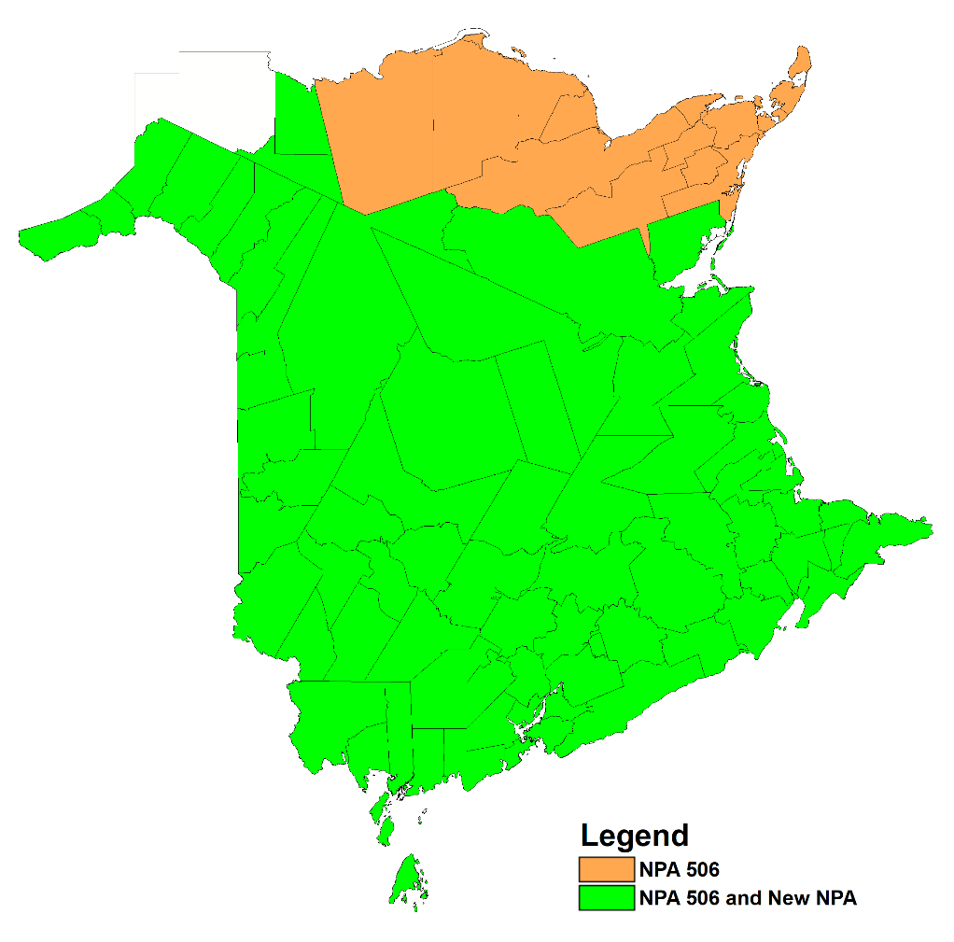
Option 2: Concentrated Overlay on MADAWASKA, NORTHUBRLD, SAINT JOHN, WESTMORLD and YORK LIRs

Slide 27
Option 2: Concentrated Overlay on MADAWASKA, NORTHUBRLD, SAINT JOHN, WESTMORLD and YORK LIRs
This Relief Option would overlay a new NPA Code over the MADAWASKA, NORTHUBRLD, SAINT JOHN, WESTMORLD and YORK LIRs (74 Exchange Areas) and the remaining GLOUCESTER LIR (14 Exchange Areas) in the province of New Brunswick would continue to grow using CO Codes from NPA 506.
This concentrated overlay would have to be implemented in 1Q 2019 to ensure a quantity of NXXs is available in NPA 506 for forecast growth in the remainder of the province.
With this Relief Option, the number of separate Relief Planning areas in New Brunswick would increase from one to two.
NPA 506 and the new NPA would be expected to exhaust in 1Q 2055 and 4Q 2054 respectively.
Based on July 2017 R-NRUF results, the latest Relief Implementation is 1Q 2021.
Based on July 2017 R-NRUF results, NPA 506 PED is 1Q 2045 and new NPA is 2Q 2059.

Slide 28
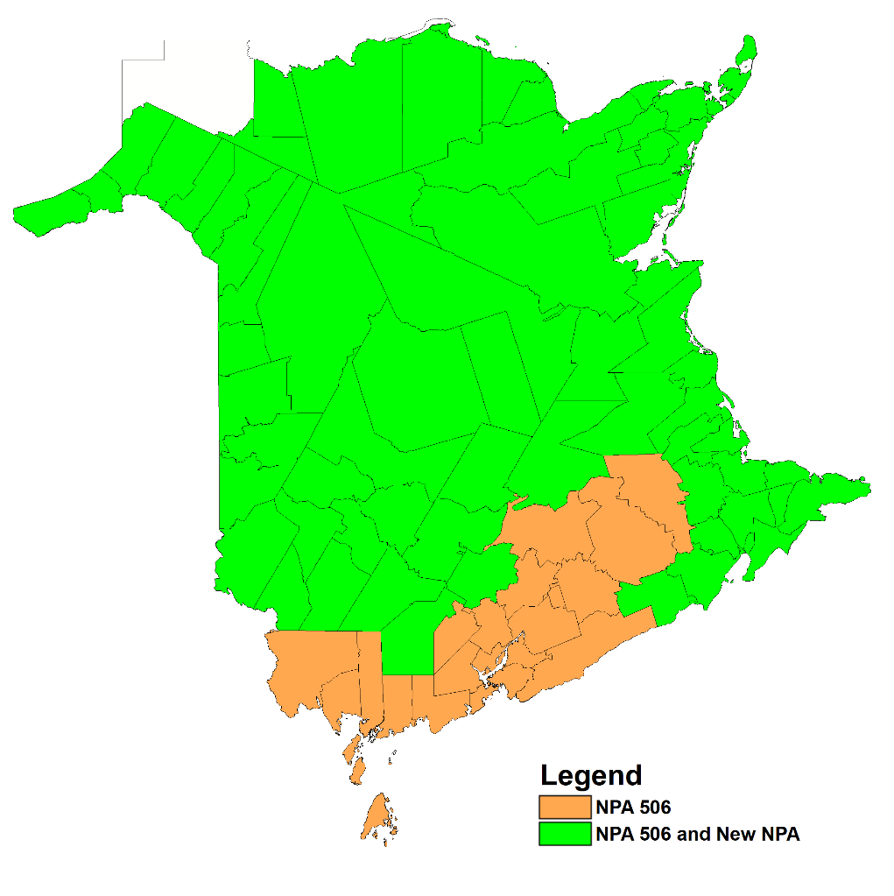
Option 3: Concentrated Overlay on GLOUCESTER, MADAWASKA, NORTHUBRLD, WESTMORLD and YORK LIRs

Slide 29
Option 3: Concentrated Overlay on GLOUCESTER, MADAWASKA,
NORTHUBRLD, WESTMORLD and YORK LIRs
This Relief Option would overlay a new NPA Code over the GLOUCESTER, MADAWASKA, NORTHUBRLD, WESTMORLD and YORK LIRs (66 Exchange Areas) and the remaining SAINT JOHN LIR (22 Exchange Areas) in the province of New Brunswick would continue to grow using CO Codes from NPA 506.
This concentrated overlay would have to be implemented in 1Q 2019 to ensure a quantity of NXXs is available in NPA 506 for forecast growth in the remainder of the province.
With this Relief Option, the number of separate Relief Planning areas in New Brunswick would increase from one to two.
After this concentrated overlay, NPA 506 and the new NPA would be expected to exhaust in 1Q 2047 and 3Q 2056 respectively.
Based on July 2017 R-NRUF results, the latest Relief Implementation is 1Q 2021.
Based on July 2017 R-NRUF results, NPA 506 PED is 2Q 2039 and new NPA is 3Q 2061.

Slide 30
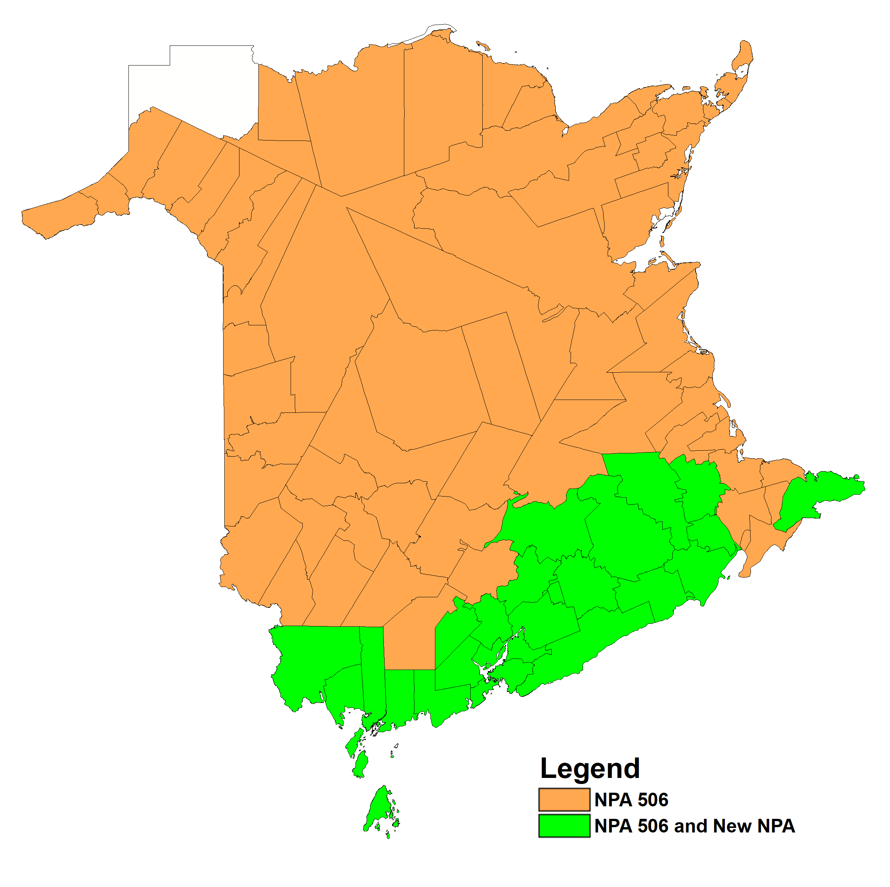
Option 4: Concentrated Overlay on SAINT JOHN and WESTMORLD LIRs

Slide 31
Option 4: Concentrated Overlay on SAINT JOHN and WESTMORLD LIRs
This Relief Option would overlay a new NPA Code over the SAINT JOHN and WESTMORLD LIRs (27 Exchange Areas) and the remaining GLOUCESTER, MADAWASKA, NORTHUBRLD and YORK LIRs (61 Exchange Areas) in the province of New Brunswick would continue to grow using CO Codes from NPA 506.
This concentrated overlay would have to be implemented in 1Q 2019 to ensure a quantity of NXXs is available in NPA 506 for forecast growth in the remainder of the province.
With this Relief Option, the number of separate Relief Planning areas in New Brunswick would increase from one to two.
After this concentrated overlay, NPA 506 and the new NPA would be expected to exhaust in 2Q 2026 and 4Q 2111 respectively.
Based on July 2017 R-NRUF results, the latest Relief Implementation is 1Q 2021.
Based on July 2017 R-NRUF results, NPA 506 PED is 2Q 2027 and new NPA is 3Q 2116.

Slide 32
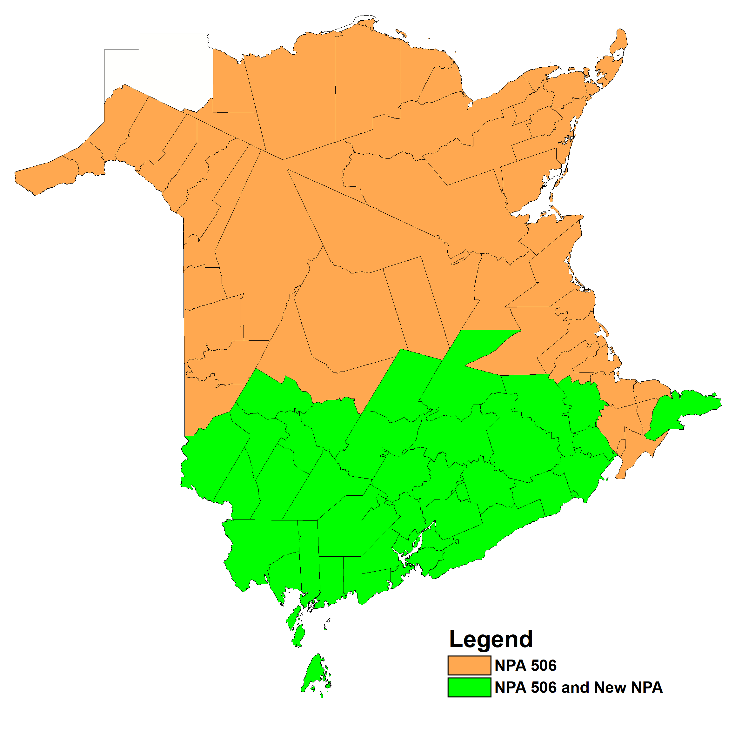
Option 5: Concentrated Overlay on SAINT JOHN, WESTMORLD and YORK LIRs

Slide 33
Option 5: Concentrated Overlay on SAINT JOHN, WESTMORLD and YORK LIRs
This Relief Option would overlay a new NPA Code over the SAINT JOHN, WESTMORLD and YORK LIRs (40 Exchange Areas) and the remaining GLOUCESTER, MADAWASKA and NORTHUBRLD LIRs (48 Exchange Areas) in the province of New Brunswick would continue to grow using CO Codes from NPA 506.
This concentrated overlay would have to be implemented in 1Q 2019 to ensure a quantity of NXXs is available in NPA 506 for forecast growth in the remainder of the province.
With this Relief Option, the number of separate Relief Planning areas in New Brunswick would increase from one to two.
After this concentrated overlay, NPA 506 and the new NPA would be expected to exhaust in 1Q 2029 and 2Q 2085 respectively.
Based on July 2017 R-NRUF results, the latest Relief Implementation is 1Q 2021.
Based on July 2017 R-NRUF results, NPA 506 PED is 4Q 2028 and new NPA is 2Q 2090.

Slide 34
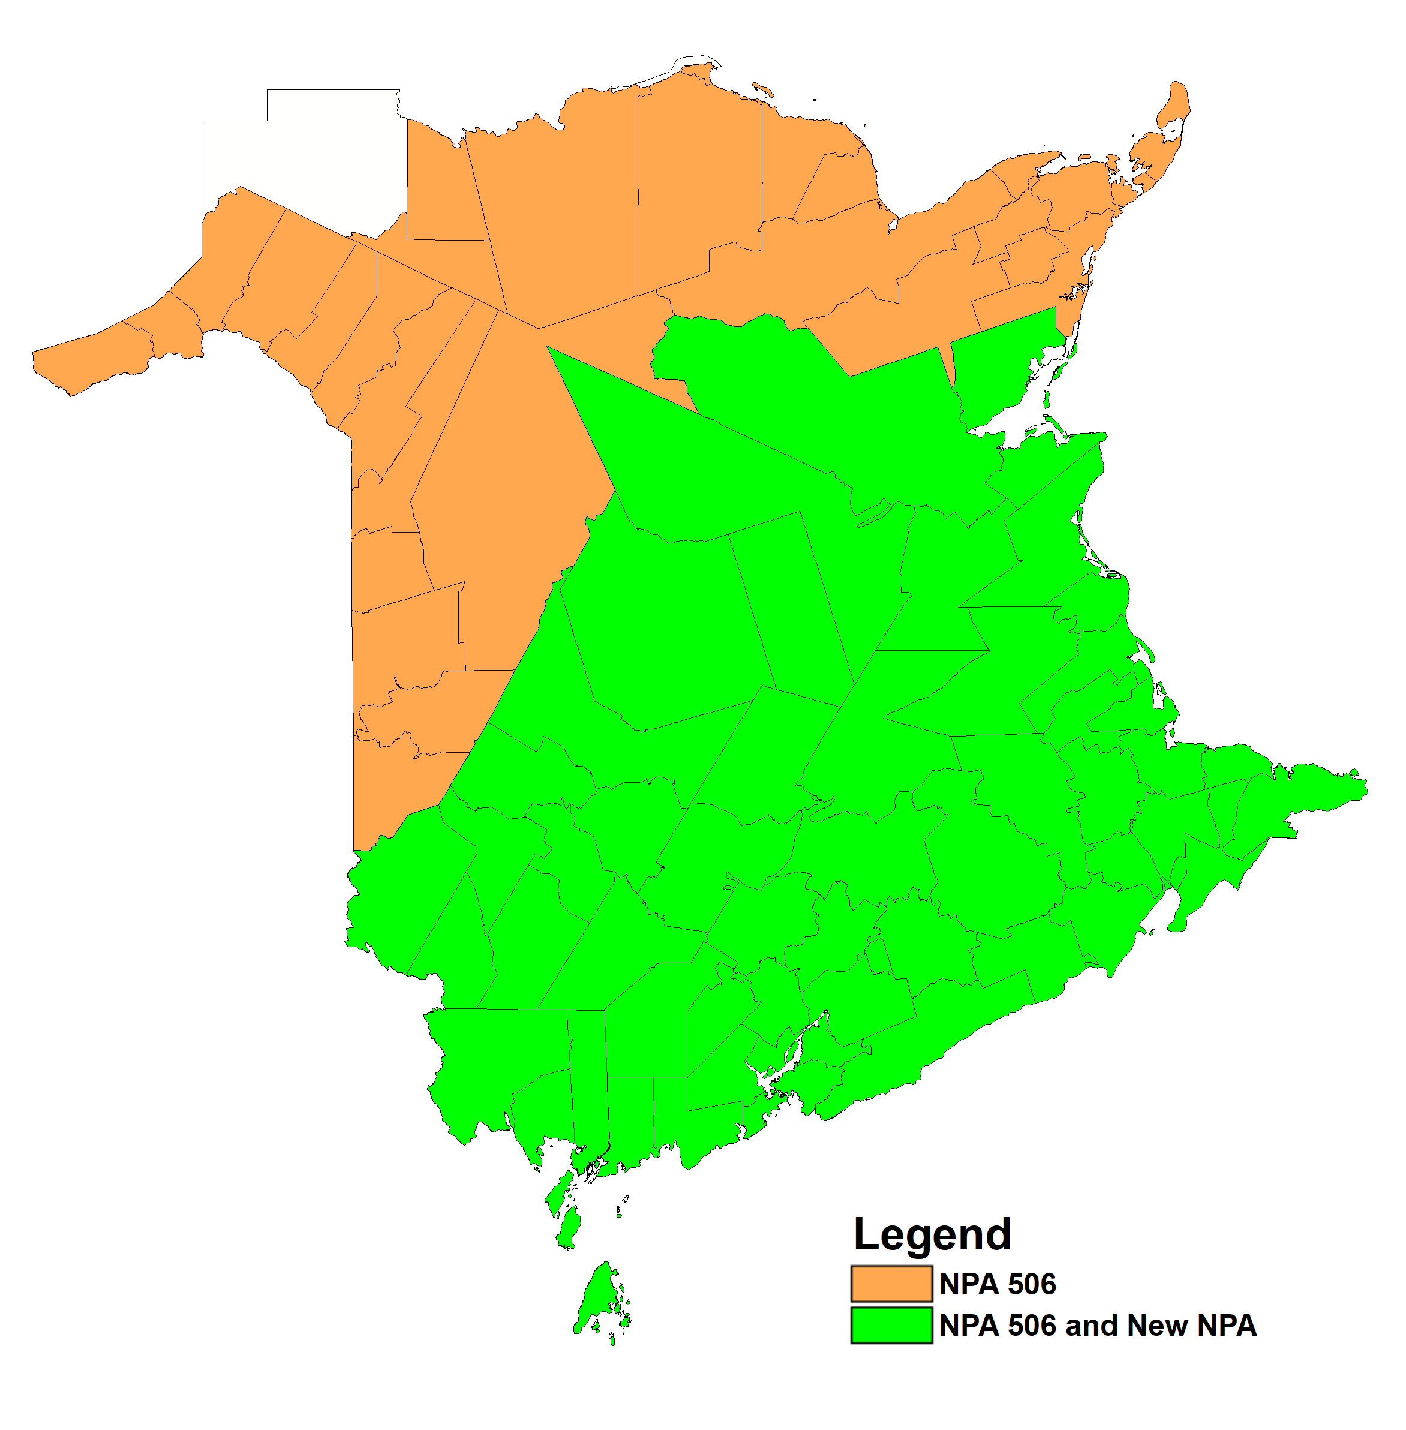
Option 6: Concentrated Overlay on NORTHUBRLD, SAINT JOHN, WESTMORLD and YORK LIRs

Slide 35
Option 6: Concentrated Overlay on NORTHUBRLD, SAINT JOHN, WESTMORLD and YORK LIRs
This Relief Option would overlay a new NPA Code over the NORTHUBRLD, SAINT JOHN, WESTMORLD and YORK LIRs (59 Exchange Areas) and the remaining GLOUCESTER and MADAWASKA LIRs (29 Exchange Areas) in the province of New Brunswick would continue to grow using CO Codes from NPA 506.
This concentrated overlay would have to be implemented in 1Q 2019 to ensure a quantity of NXXs is available in NPA 506 for forecast growth in the remainder of the province.
With this Relief Option, the number of separate Relief Planning areas in New Brunswick would increase from one to two.
After this concentrated overlay, NPA 506 and the new NPA would be expected to exhaust in 1Q 2036 and 1Q 2064 respectively.
Based on July 2017 R-NRUF results, the latest Relief Implementation is 1Q 2021.
Based on July 2017 R-NRUF results, NPA 506 PED is 2Q 2033 and new NPA is 4Q 2068.

Slide 36
Summary of Relief Options
Relief Option |  | New NPA Implementation Date | Projected Exhaust Dates
# | Description |  | NPA 506 | New NPA
1 | Distributed Overlay of new NPA Code on NPA 506 | 4Q 2020 4Q 2023 | 4Q 2021 4Q 2024 | 2Q 2053 4Q 2055
2 | Concentrated Overlay on MADAWASKA, NORTHUBRLD, SAINT JOHN, WESTMORLD and YORK LIRs | 1Q 2019 1Q 2021 | 1Q 2055 1Q 2045 | 4Q 2054 2Q 2059
3 | Concentrated Overlay on GLOUCESTER, MADAWASKA, NORTHUBRLD, WESTMORLD and YORK LIRs | 1Q 2019 1Q 2021 | 1Q 2047 2Q 2039 | 3Q 2056 3Q 2061
4 | Concentrated Overlay on SAINT JOHN and WESTMORLD LIRs | 1Q 2019 1Q 2021 | 2Q 2026 2Q 2027 | 4Q 2111 3Q 2116
5 | Concentrated Overlay on SAINT JOHN, WESTMORLD and YORK LIRs | 1Q 2019 1Q 2021 | 1Q 2029 4Q 2028 | 2Q 2085 2Q 2090
6 | Concentrated Overlay on NORTHUBRLD, SAINT JOHN, WESTMORLD and YORK LIRs | 1Q 2019 1Q 2021 | 1Q 2036 2Q 2033 | 1Q 2064 4Q 2068
Due to the PED moving out, the ideal implementation date for Option #1 would be 2Q 2023 (18 months) but is up to the RPC.
Dates have been updated using July 2017 R-NRUF results

Slide 37
Impacts
Customers
  in preparation for the assignment of CO Codes and telephone numbers in the new/extended NPA, customers must accommodate the additional NPA in their lists, tables, systems and equipment
Customers’ Equipment
  Automatic Dialer
  Fax Machines
  Call Forwarding
  Cellular Phones
  Burglar Alarms
  Voice Messaging Use
  Speed Calls List
  DISA Numbers
  CDR Software
  ACD Operations
  Modems
  PBXs
  Centrex
  Key Systems

Slide 38
Impacts (cont’d)
Telecommunications Service Providers
  systems etc. must accommodate additional NPA in the NPA 506 area
Telecommunication Operations
  Planning, Provisioning, Network Operations
Residential Sales and Service
  Business Office, I&R, Sales and Support
Corporate Communications
  Public Information
Finance
  Support
Business Division
  Sales, Public Communication Services, Customer Provided Equipment
Marketing
  Business Development, Forecast Rates and Tariff
System Solutions
  System Dev. (Network)
  System Dev. (Revenue)
Regulatory Matters

Slide 39
Impacts (cont’d)
Others
  Resellers, Rebillers
  International Carriers
  CPE Community: Vendors, Maintenance, Owners
  Radio Paging Community: Pagers and Beepers
  Industry Associations: Hotel, Alarm, Paging, Apartment Owners

